Slide 1
Improved Expert Search
Z
M
S
Z
M
S
Team ZMS (Zacharia Rupp, Mriganka Sarma, Sai Ranganathan)

Slide 2
Introduction
Z
M
S
What is ExpertSearch System
The System As It Is

Slide 3
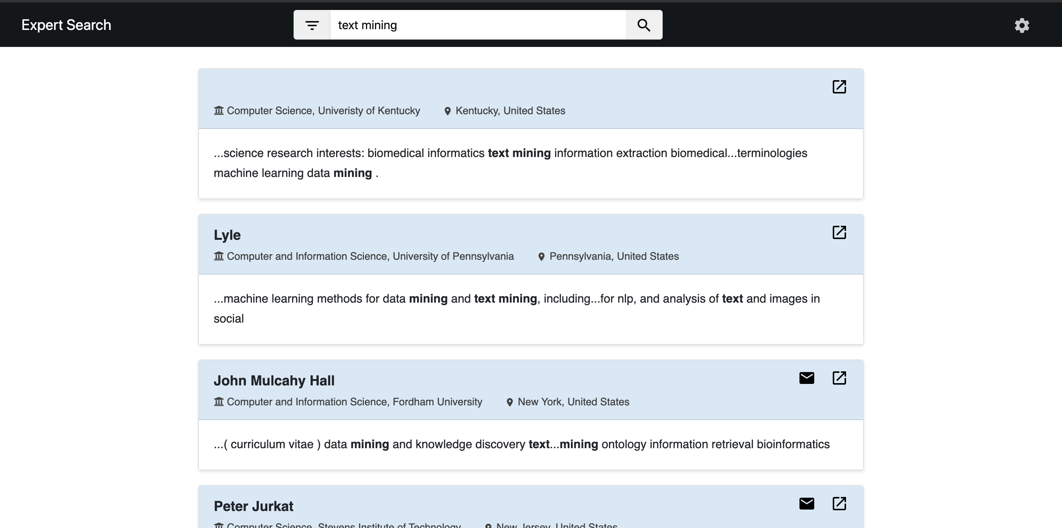
The System As It Is
Z
M
S

Slide 4
Challenges of Current System
Z
M
S
Manual Process for Directory URL Identification
Manual Process for Faculty Webpage Identification
Need for Structuring of Faculty Information
Need for Improved Extraction Methods

Slide 5
Proposed Improvements
Z
M
S
Automatic Scraping of Faculty Directory and Faculty Webpages
Mining Top Research Topics of Faculty
Improved Email Extraction
Improved UI for Better Visualization of Structured Data

Slide 6
Setup Instructions
Z
M
S
Clone the project repository
$ git clone https://github.com/sairanga123/CourseProject.git
Create Anaconda python 2.7 environment
Install python packages
gensim
nltk
gunicorn
bs4
metapy

Slide 7
Usage Instructions
Z
M
S
Main Functional Categories:
Automatic Scraping
Topic Mining
Faculty Search in UI

Slide 8
Usage Instructions (contd.)
Z
M
S
Automatic Scraping
$ cd ExpertSearch/AutoScraper
$ python ./auto_scraper.py –d –t

Slide 9
Usage Instructions (contd.)
Z
M
S
Topic Miner

Slide 10
Usage Instructions (contd.)
Z
M
S
Email Extraction

Slide 11
Usage Instructions (contd.)
Z
M
S
Running the Backend Server
$ gunicorn server:app -b 127.0.0.1:8095
Running Faculty Search from the UI
localhost:8095

Slide 12
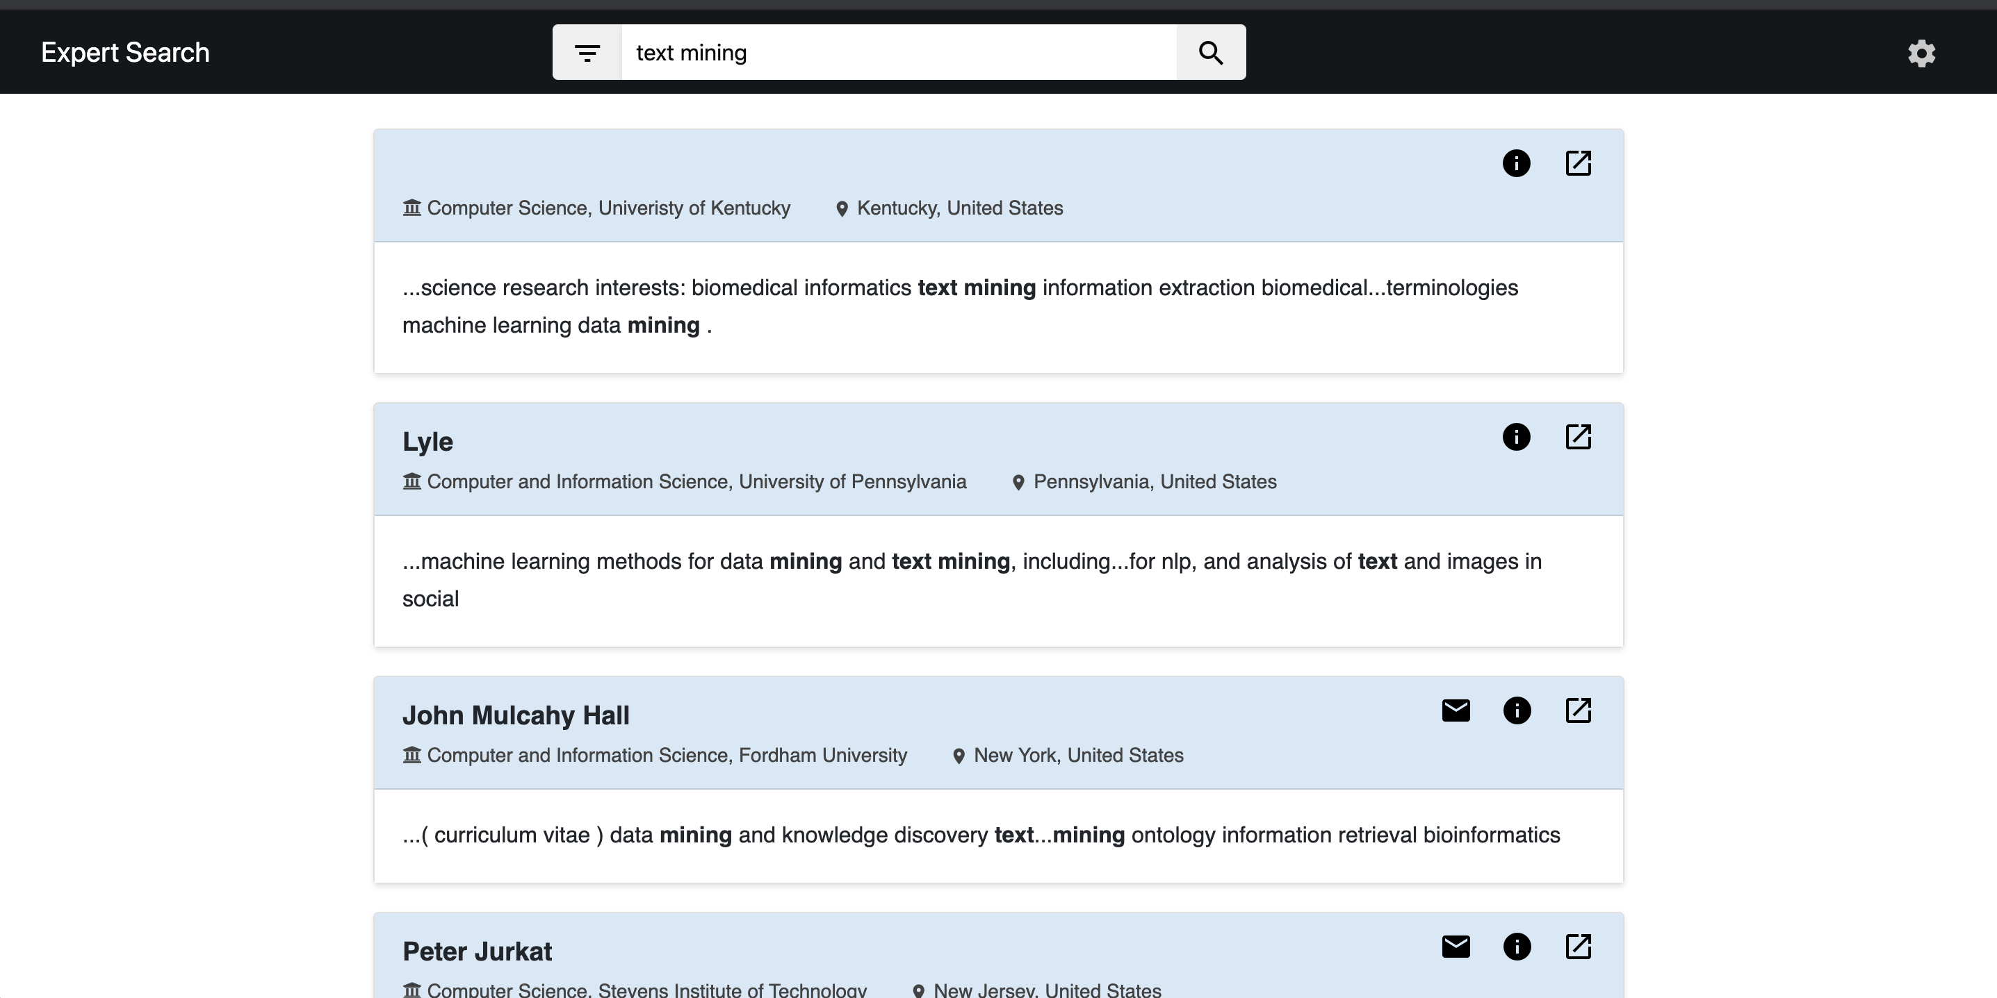
Example Usage
Z
M
S

Slide 13
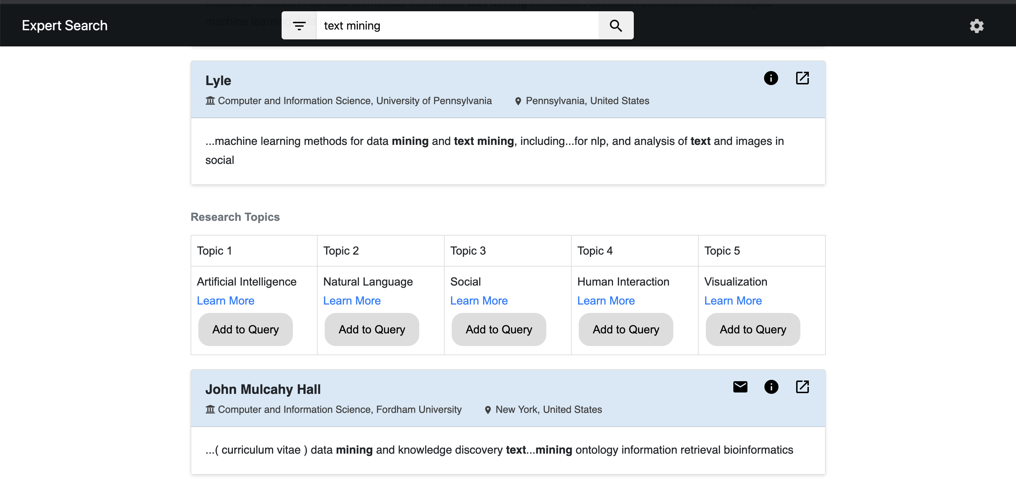
Example Usage (contd.)
Z
M
S

Slide 14
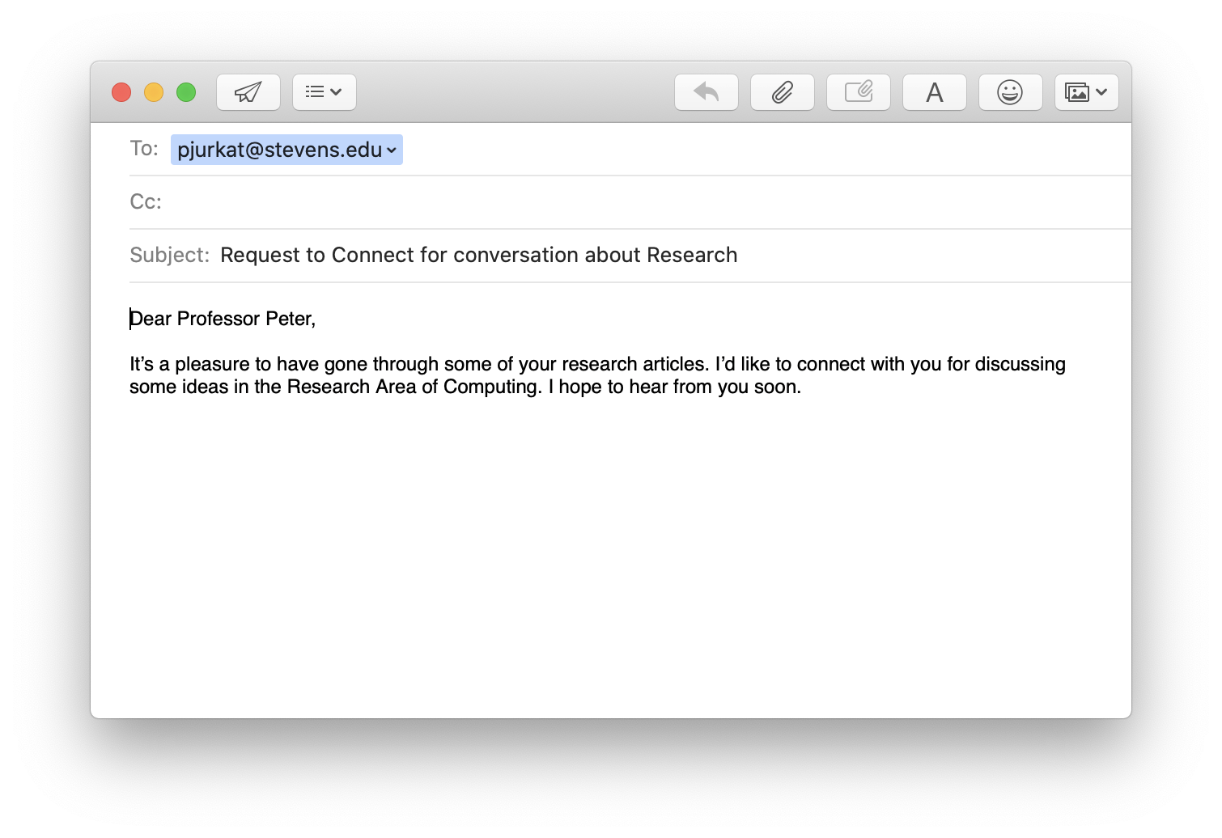
Example Usage (contd.)
Z
M
S

Slide 15
Thank You
Z
M
S
Z
M
S

